Slide 1
PSCS-18 DASHBOARD FOR REAL-TIME MONITORING OF CONSTRUCTION PROJECTS
Review-1
Batch Number: CSE-G64
Under the Supervision of,
Dr. PRASAD P S
Assistant Professor ( Selection-Grade )
School of Computer Science and Engineering
Presidency University
Roll Number | Student Name
20211CSE0497 | YASHAS R GOWDA
20211CSE0843 | SHASHANK K
20211CSE0847 | DISHA S
Name of the Program: PSCS
Name of the HoD: Dr. ASIF MOHAMMED H B
Name of the Program Project Coordinator: Mr. AMARNATH J L & Dr. JAYANTHI K
Name of the School Project Coordinators: Dr. ABDUL KHADAR A

Slide 2
CONTENT
Introduction
Literature Survey
Existing Methods-Drawbacks
Proposed Method
Objectives
Architecture Diagram
Hardware and Software Details
Time Line by Gantt Chart
Conclusion
Github link
References

Slide 3
INTRODUCTION
In today's fast-paced construction industry, efficiency, safety, and resource management are paramount. By leveraging IoT devices and advanced AI/ML tools, we can revolutionize the way construction projects are monitored in real time.
This approach enables comprehensive tracking of equipment and manpower, providing valuable insights into their utilization and performance. Furthermore, real-time data analysis and predictive modeling enhance safety measures, ensuring a secure and productive work environment.
Our innovative dashboards are designed to present this data in an intuitive and user-friendly manner, offering a holistic view of project operations at a glance.

Slide 4
LITERATURE SURVEY
Web-Based Dashboards: Enhance real-time project tracking and collaboration.
→ Alwan et al. (2022), IEEE Xplore
IoT for Real-Time Monitoring: Improves worker safety, equipment tracking, and site surveillance.
→ Chen et al. (2019), Computers in Industry
AI & Predictive Analytics: Helps predict project delays, cost overruns, and labour shortages.
→ Singh & Bansal (2022), Journal of Computing in Civil Engineering
Big Data in Construction: Enhances scheduling efficiency and resource allocation.
→ Zhang & Zhou (2020), Automation in Construction

Slide 5
LITERATURE SURVEY
Blockchain for Secure Transactions: Ensures transparent contracts and secure payments.
→ Taylor & Harris (2018), International Journal of Project Management
Cloud-Based Collaboration: Improves accessibility, real-time updates, and cost efficiency.
→ Sun & Lu (2019), Construction Innovation
Digital Twin Technology: Enables real-time tracking through virtual construction models.
→ Patel & Gupta (2021), Advanced Engineering Informatics

Slide 6
EXISTING METHODS-DRAWBACKS
1. Manual Reporting & Spreadsheets
Method: Data is collected manually and entered into Excel sheets or reports.
- Drawbacks:
- Time-consuming and delays real-time decision-making.
- Limited collaboration and accessibility.
2. Traditional Project Management Software (e.g., MS Project, Primavera P6)
- Method: Desktop-based software tracks schedules, costs, and resources.
- Drawbacks:
- Difficult to update instantly from multiple locations.
- Limited visualization and data analytics capabilities.
3. Basic Site Surveillance & Manual Inspections
- Method: Supervisors visit sites and report progress based on observations.
- Drawbacks:
- Time-consuming and inefficient for large-scale projects.
- No automated documentation or data storage.

Slide 7
EXISTING METHODS-DRAWBACKS
4. Standalone IoT & Sensor-Based Monitoring
- Method: IoT sensors track parameters like temperature, humidity, and equipment usage.
- Drawbacks:
- Requires integration with a central dashboard for real-time analysis.
- High implementation and maintenance costs.
5. CCTV & Drone Monitoring
- Method: Cameras and drones capture site visuals for remote monitoring.
- Drawbacks:
- Lacks real-time analytics and integration with project data.
- High costs for drone operations and storage of large video data.
6. Cloud-Based Collaboration Platforms (e.g., Procore, BIM 360)
- Method: Cloud platforms enable document sharing, scheduling, and communication.
- Drawbacks:
- Expensive subscription costs for small and medium firms.
- Requires training for effective utilization.

Slide 8
PROPOSED METHODS
Data Collection and Integration
Data Gathering: Collect data from project management software, construction databases, and on-site reports.
Real-Time Data Integration: Ensure real-time data flow into the dashboard for accurate decision-making.
Dynamic Visualizations
Interactive Visuals: Use JavaScript libraries like Chart.js or Recharts to display data.
Visualizing Key Metrics: Display budget utilization and project progress metrics in an engaging way.
User Interface and Experience
Intuitive Design: Build a user-friendly interface using React.js and Material-UI components.
Customization: Enable flexibility with customizable features for different construction projects.

Slide 9
OBJECTIVES
The project aims to achieve the following objectives:
Real-Time Resource Monitoring:
Provide live updates on manpower and equipment allocation, usage, and availability.
Task and Workflow Management:
Enable tracking of tasks' progress, status, deadlines, and assigned personnel.
Efficiency Metrics:
Display key metrics like resource utilization rates, task completion rates, and project budget adherence.
Interactive Dashboard:
Include charts, graphs, and tables to offer dynamic insights into project performance

Slide 10
OBJECTIVES
CRUD Operations:
Provide full Create, Read, Update, Delete functionality for projects, tasks, and resources.
Scalable Backend:
Use PostgreSQL for robust database management and Express.js for scalable API services.
Responsive Frontend:
Build a fully responsive React-based dashboard for seamless accessibility across devices.
User Authentication:
Implement a secure admin authentication system with role-based access control

Slide 11
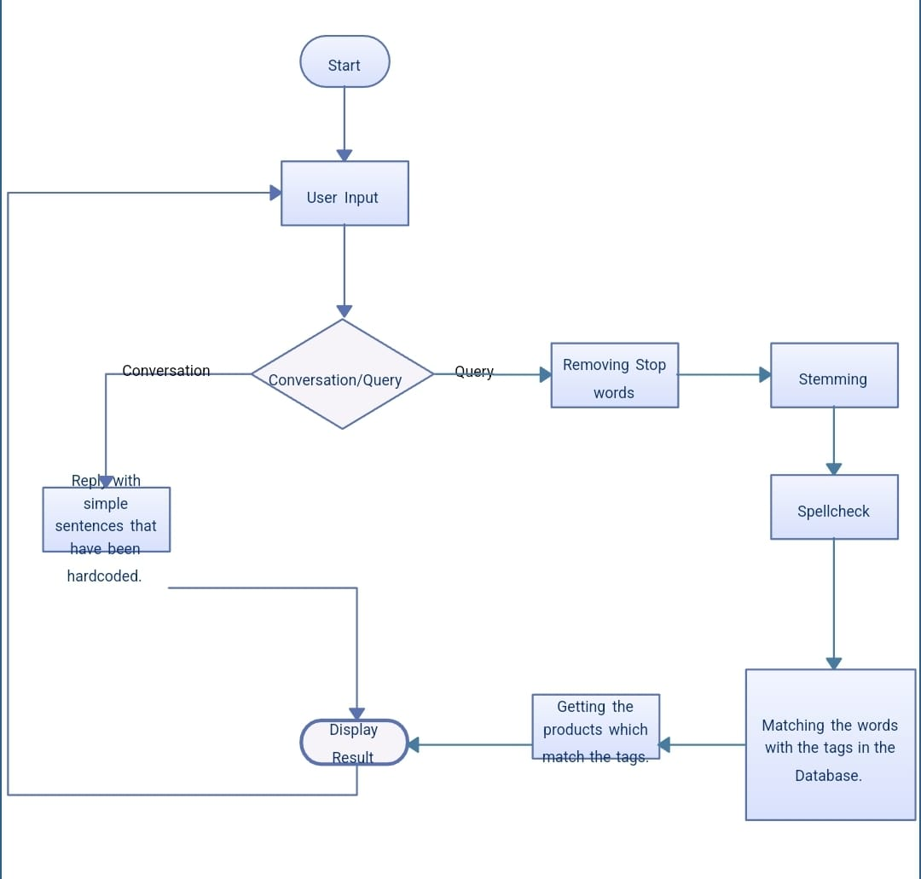
ARCHITECTURE DIAGRAM

Slide 12
HARDWARE AND SOFTWARE COMPONENTS
React.js
Material-UI
Chart.js / Recharts
HTML,CSS
Node.js
Express.js

Slide 13
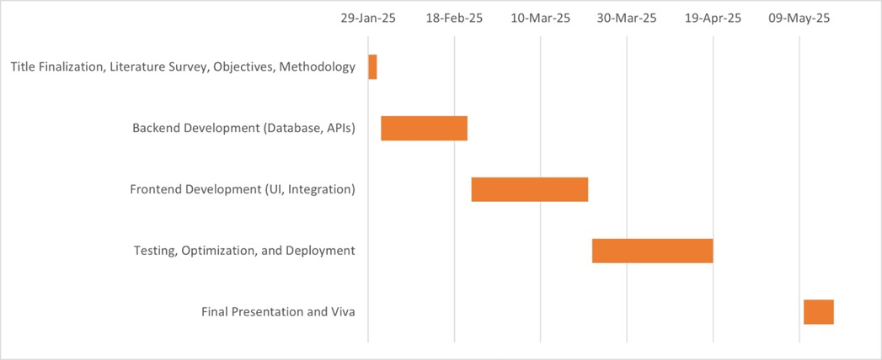
Timeline of the Project (Gantt Chart)

Slide 14
CONCLUSION
The Dashboard for Real-Time Monitoring of Construction Projects successfully provides a centralized platform for tracking project progress, resource allocation, and potential risks in real time.
This real-time monitoring dashboard significantly enhances productivity, reduces operational costs, and fosters better collaboration among teams, ultimately leading to the successful and timely completion of construction projects.

Slide 15
GITHUB LINK
https://github.com/Yashas-PU/Dashboard-for-real-time-monitoring-of-construction-projects.
It’s a public repository and everything is accessible for everyone and there is a through road map how we are going to take this project further in a readme file in Github.

Slide 16
REFERENCES
1. Alwan, H., Smith, J., & Patel, R. (2022).
Construction Project Management System Using Web Technologies. IEEE Xplore.
2. Lee, K., Park, S., & Kim, J. (2021).
A Web-Based Construction Resource Management System. Automation in Construction, 126, 103682.
3. Wang, Y., Zhang, L., & Li, H. (2020).
Developing a Real-Time Construction Site Monitoring System. Journal of Construction Engineering and Management, 146(9), 04020085.
4. Chen, J., Huang, S., & Xu, M. (2019).
Integration of IoT and BIM for Smart Construction Management. Computers in Industry, 109, 53–66.
5. Singh, R., & Bansal, V. (2022).
AI-Based Predictive Analytics for Construction Project Delays. Journal of Computing in Civil Engineering, 36(3), 04022015.

Slide 17
REFERENCES
6. Zhang, X., & Zhou, Y. (2020).
Big Data Analytics for Construction Management. Automation in Construction, 119, 103293.
7. Taylor, J., & Harris, D. (2018).
Blockchain for Construction Supply Chain Management. International Journal of Project Management, 36(5), 795–805.
8. Sun, W., & Lu, H. (2019).
Cloud Computing for Real-Time Construction Project Monitoring. Construction Innovation, 19(3), 321–338.
9. Patel, A., & Gupta, P. (2021).
Digital Twins for Construction Progress Tracking. Advanced Engineering Informatics, 47, 101240.
10. Rogers, M., & Bennett, L. (2020).
Risk Management in Construction Projects Using Data Analytics. Engineering, Construction, and Architectural Management, 27(5), 1243–1258.

Slide 18



